Slide 1

AWS Cloud Masters
Sachin Agarwal

Slide 2
AgenDa
About the Trainer
Course Overview
Introduction to Cloud
Why Learn AWS
AWS Certification
AWS Learning Path
Benefits of Certification
Exam Coverage
Account Creation in AWS

Slide 3
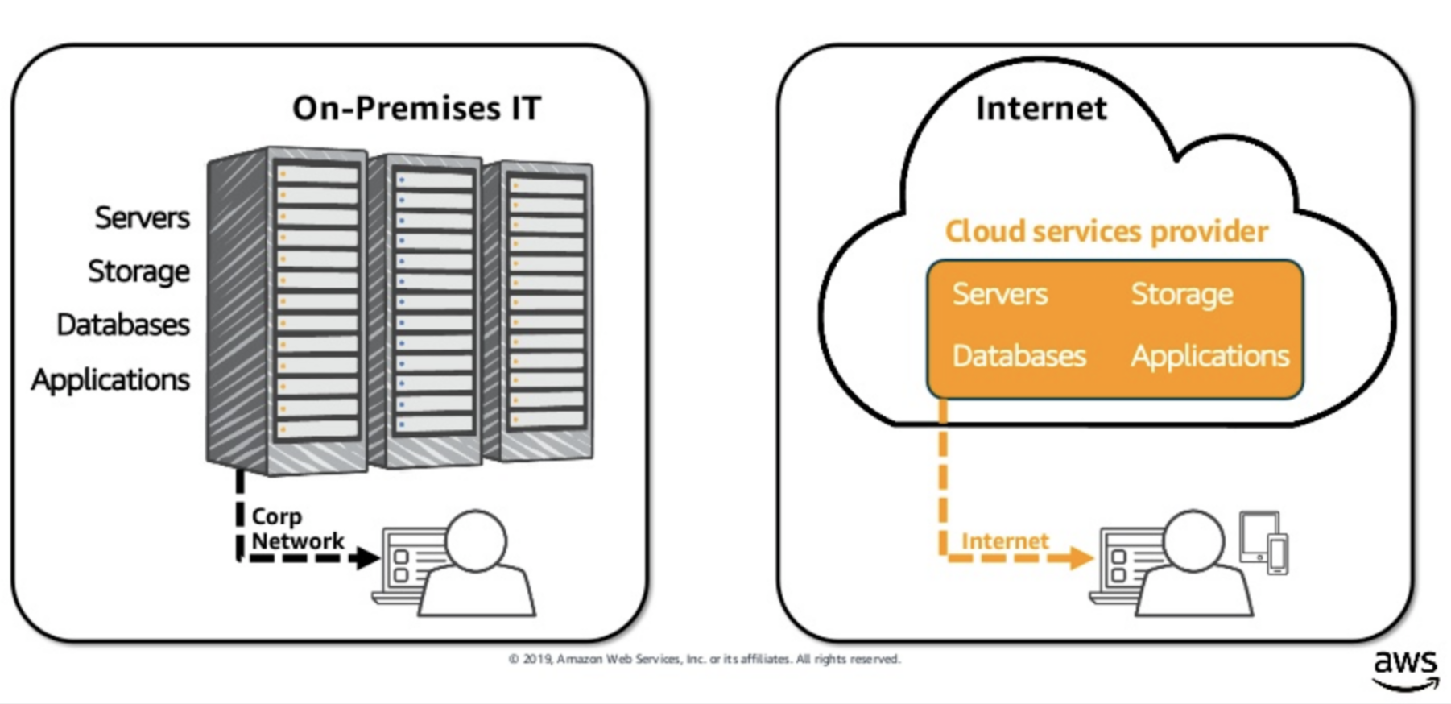
What is Cloud?

Slide 4
Introduction to Cloud Computing
Cloud computing is shared pools of configurable computer system resources and higher-level services that can be rapidly provisioned with minimal management effort, often over the Internet. Cloud computing relies on sharing of resources to achieve coherence and economies of scale, similar to a public utility.
Service models
“Infrastructure as a service” (IaaS)
“Platform as a service" (PaaS)
Software as a service (SaaS)
Deployment models
Private cloud - On Premise
Public cloud- Multiple data centre contain data of multiple companies
Hybrid cloud - Combination of Public & Private
Major cloud Providers are Amazon Web Services (AWS), Microsoft Azure Services, Google Cloud Platform, Akamai, Alibaba Cloud, etc.

Slide 5
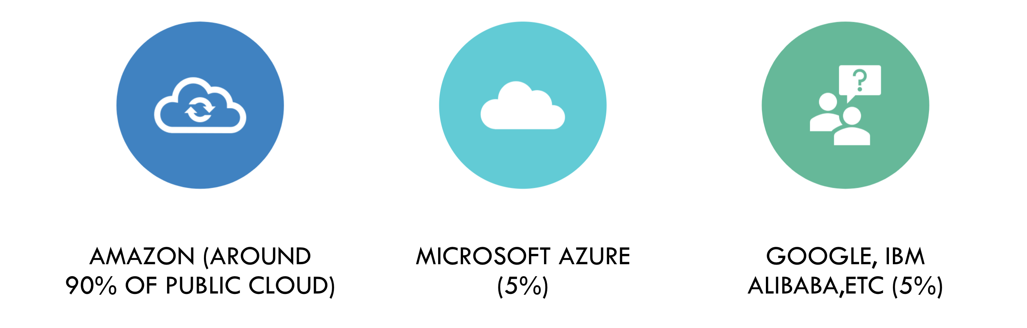
DIFFERENT CLOUD VENDORS

Slide 6
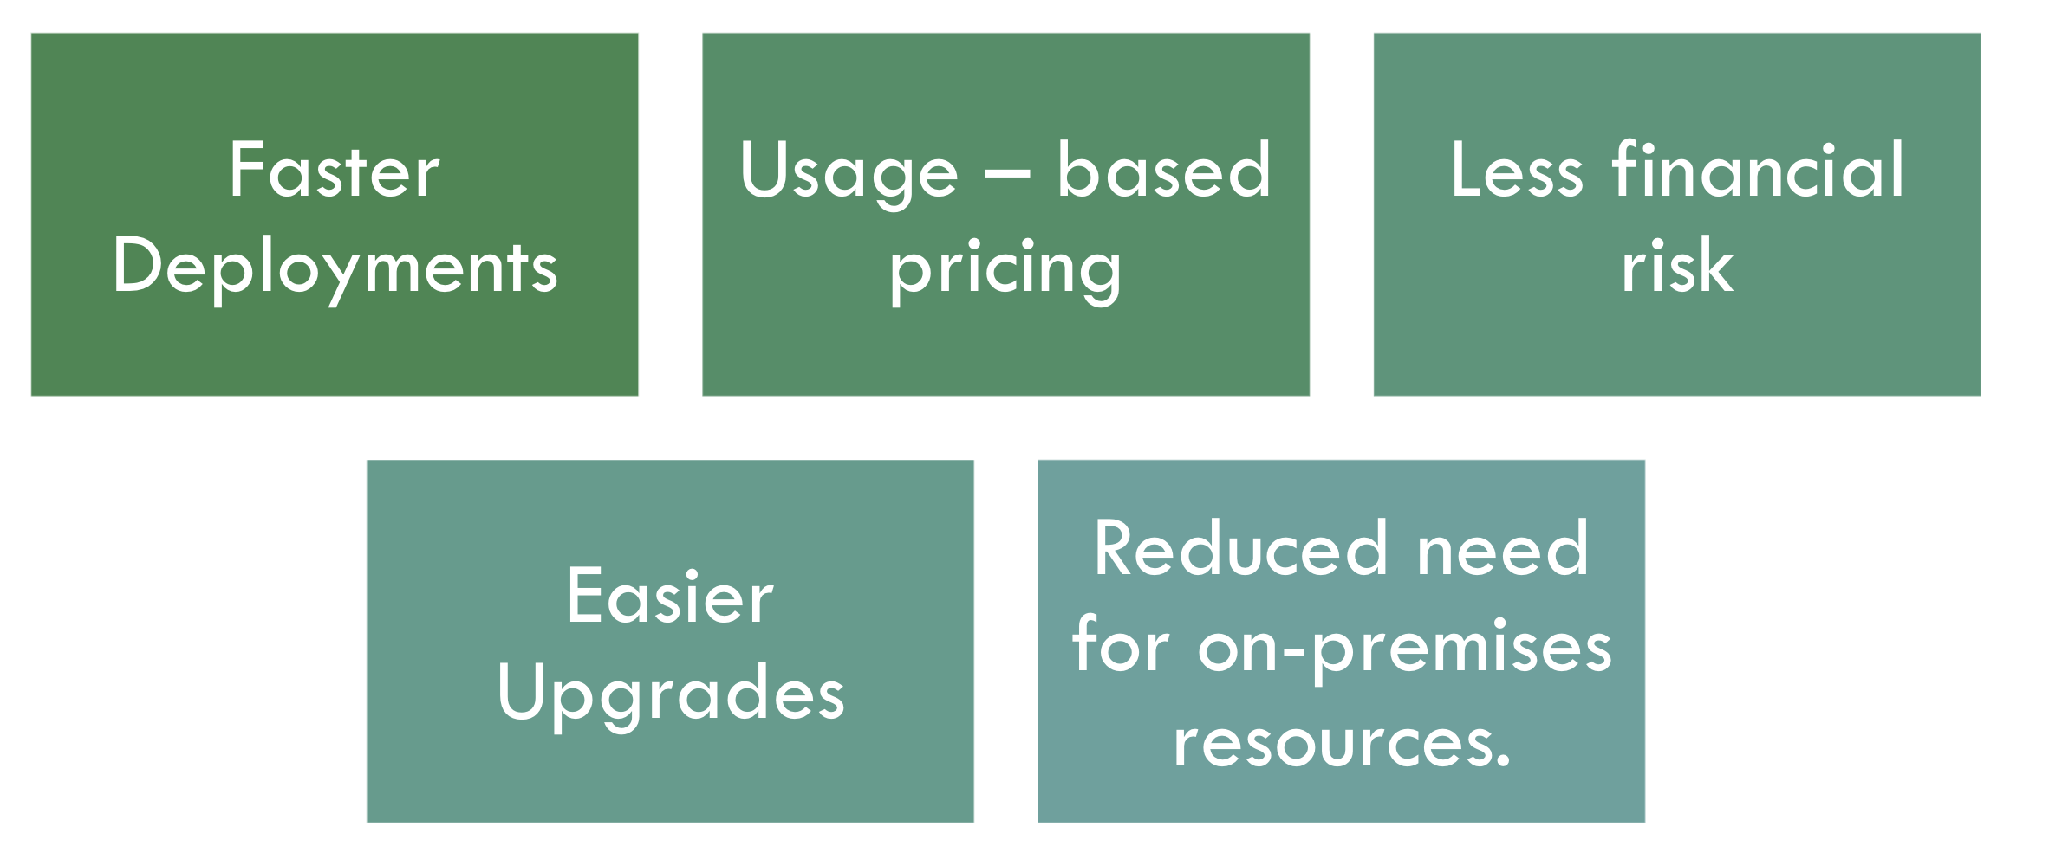
BENEFITS OF CLOUD COMPUTING

Slide 7
INTRODUCTION TO AWS
Amazon Web Services (AWS) is a cloud service provider which provides compute, storage, networking and many other services.
We can say, AWS Cloud is a whole collection of worldwide distributed servers and services that are connected to the Internet for consumption by customers.

Slide 8
WHY LEARN AWS?
Fastest growing cloud computing platform on the planet.
Market Leader
Largest public cloud computing platform.
More and more organizations are outsourcing their IT to AWS.
AWS certifications are most popular certifications currently in market.
Netflix, Reddit, Pinterest are running on AWS.
AWS Services (Compute, Database, Internet of Things, Storage, Security, etc.)

Slide 9
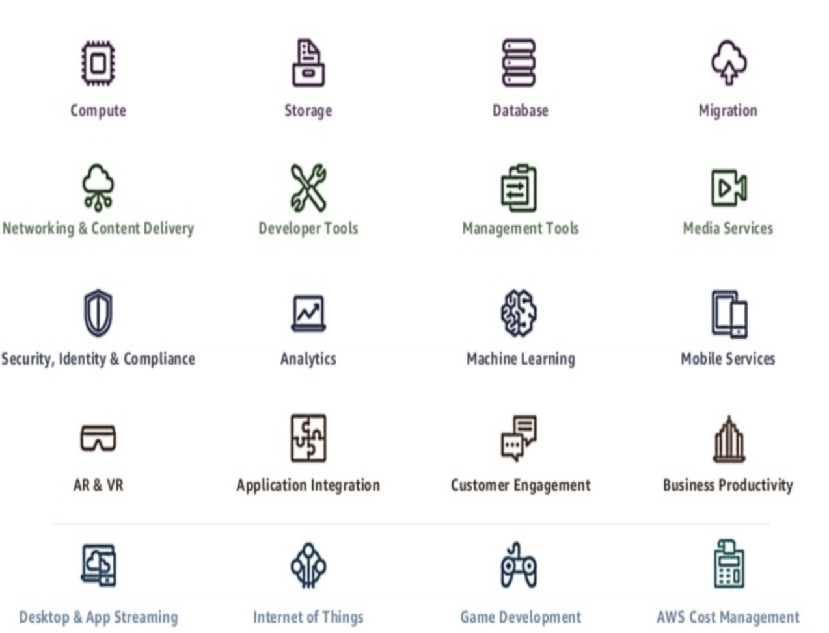
WHy Customers choose AWS?

Slide 10

AWS Certifications
AWS Certified Solutions Architect - Associate
AWS Certified Developer - Associate
AWS Certified SysOps Administrator - Associate
AWS Certified Solutions Architect - Professional
AWS Certified DevOps Engineer - Professional

Slide 11
Let's explore AWS site & CERTIFCATION PAGE
https://aws.amazon.com/certification/certification-prep/?nc2=sb_ce_ep

Slide 12
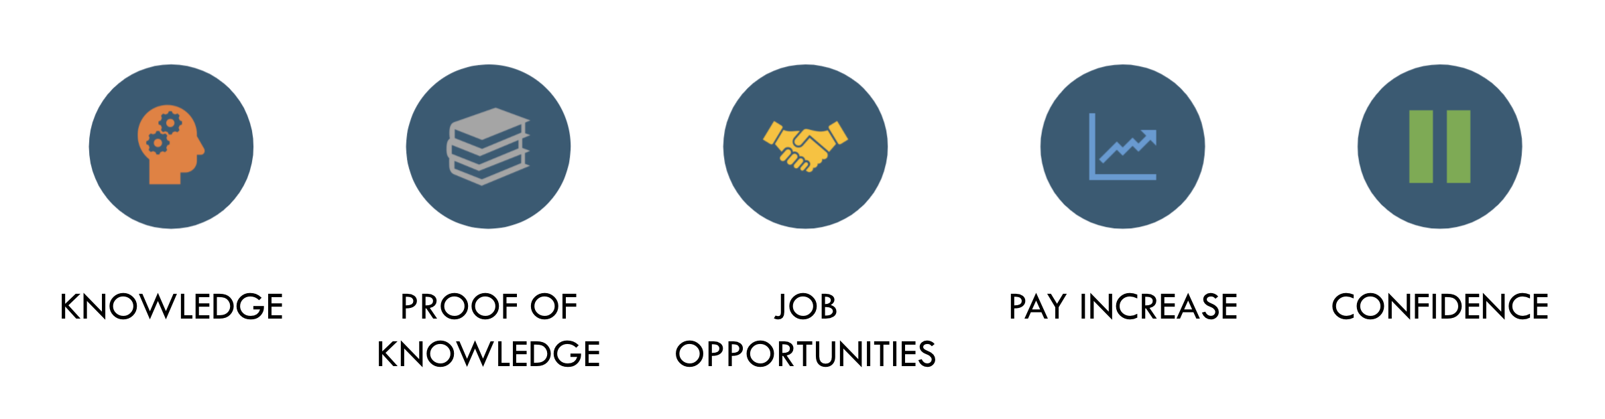
BENEFITS of CERTIFICATION

